Slide 1

The Asking Conversation
A Kinder Gentler Way to Get
Your Donors to Say Yes

Slide 2


A Delicate Balance

Slide 3
The Asking Process
Select
prospects
Prepare
to meet
Schedule
meeting
Meet
Follow
through
1
2
3
4
5

Slide 4
SETTING UP THE VISIT
Letter or email
Then call to schedule
Handle objections
Persist!
Confirm time and location

Slide 5

HANDLING OBJECTIONS
No time
Too busy
No need to meet
I’ll send a check
Other expenses
Not interested

Slide 6
GENTLE PERSUASION
The 3 F’s
FEEL: I understand how you feel
FELT: I’ve felt that too
FOUND: But I’ve found that…

Slide 7
THE MEETING

Slide 8

GET CURIOUS!

Slide 9
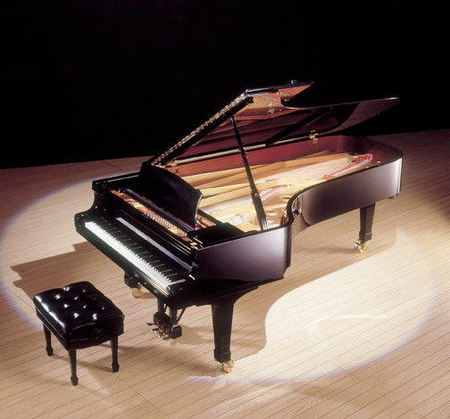
Become a Sounding Board

Slide 10


Slide 12

Notes:
Crowd source fundraising and investing.

Slide 13
Asking is an Intentional Conversation.
HERE
THERE
Notes:
Crowd source fundraising and investing.

Slide 14

A 6-Part Pattern for Intentional Conversations
ASK
EXPLORE
EXPLORE
CONFIRM
SETTLE
CONFIRM

Slide 15
You are both conductor and participant.
ASK
EXPLORE
EXPLORE
CONFIRM
SETTLE
CONFIRM

Slide 16
SETTLE
Small talk until everyone’s attention is fully in the room.
ASK
EXPLORE
EXPLORE
CONFIRM
SETTLE
CONFIRM

Slide 17
SETTLE
Small talk until everyone’s attention is fully in the room.
Shall we get
to work?
ASK
EXPLORE
EXPLORE
CONFIRM
SETTLE
CONFIRM

Slide 18
CONFIRM
1. Purpose of visit
2. Amount of time
ASK
EXPLORE
CONFIRM
EXPLORE
SETTLE
CONFIRM

Slide 19
CONFIRM
1. Purpose of visit
2. Amount of time
May I ask you
some questions?
ASK
EXPLORE
CONFIRM
EXPLORE
SETTLE
CONFIRM

Slide 20
EXPLORE
intersecting interests between
the donor and the organization
ASK
EXPLORE
EXPLORE
CONFIRM
SETTLE
CONFIRM

Slide 21
EXPLORE
intersecting interests between
the donor and the organization
This might interest you.
ASK
EXPLORE
EXPLORE
CONFIRM
SETTLE
CONFIRM

Slide 22
ASK
Grows out of donor’s interests
ASK
EXPLORE
EXPLORE
CONFIRM
SETTLE
CONFIRM

Slide 23
ASK
Grows out of donor’s interests
Would you consider
a gift of $______?
ASK
EXPLORE
EXPLORE
CONFIRM
SETTLE
CONFIRM

Slide 24
EXPLORE
Discuss the possibility and terms of a gift.
ASK
EXPLORE
EXPLORE
CONFIRM
SETTLE
CONFIRM

Slide 25
EXPLORE
Discuss the possibility and terms of a gift.
Let’s summarize and review next steps
ASK
EXPLORE
EXPLORE
CONFIRM
SETTLE
CONFIRM

Slide 26
CONFIRM
Restate agreement and clarify next steps.
ASK
EXPLORE
EXPLORE
CONFIRM
SETTLE
CONFIRM

Slide 27
ROLES
Solicitor/Prospective Donor
100/0
25/75
ASK
50/50
90/10
EXPLORE
EXPLORE
CONFIRM
50/50
90/10
SETTLE
CONFIRM

Slide 28
TIMING
(Very) Approximate
2-3
minutes
15-20
minutes
ASK
15-20
minutes
2-3
minutes
EXPLORE
EXPLORE
CONFIRM
5-10
minutes
3-5
minutes
SETTLE
CONFIRM

Slide 29

Want to go out to dinner?
Try an INTENTIONAL conversation.

Slide 30
Shift the Balance

Slide 31
Asking as an Intentional Conversation
ASK
EXPLORE
EXPLORE
CONFIRM
SETTLE
CONFIRM

Slide 32
AndreaKihlstedt.com/MOSAIC
AndreaKihlstedt@gmail.com

